Slide 1

Quality Improvement

Slide 2
Mon Health Strategic Plan
Goal for
Quality and Safety
“Deliver high quality, safe, consistent and coordinated patient care”

Slide 3
Overview
Healthcare quality indicators are monitored and reported to CMS on specific patient care practices which are evidence based and improve patient outcomes. Some measures are related to the direct care that the patient receives, and some are related to efficiency of our care processes.
The performance measures are for both the inpatient and outpatient populations that we serve.
Create reliable, comparative performance information on which consumers can rely to make informed decisions about their care.
Ensure practitioners and provider organizations are held accountable for the quality and efficiency of their performance.
Support quality improvement activities.
Healthcare institutions are judged by their performance on certain standards and are rewarded financially based on the quality of care that they provide.
.

Slide 4
SEPSIS
Early Management Bundle
Severe Sepsis/Septic Shock
The evidence cited for all components of this measure is directly related to decreases in organ failure, overall reductions in hospital mortality, length of stay, and cost of care.

Slide 5
Definitions
Severe Sepsis
Suspected or Actual Infection + 2 SIRs Criteria + Organ Dysfunction
Septic Shock
Severe Sepsis + Persistent Hypotension after Fluid Bolus
OR
Severe Sepsis + Lactate level > 4 mmol/L

Slide 6
Sepsis Care
The electronic medical record scans for SIRS criteria.
When recognized, an alert is sent to the nurse.
The nurse completes infection screening.
If “yes” is answered, an organ dysfunction screening is completed.

Slide 7
Sepsis Care
If the patient is organ dysfunction positive, the provider orders plans outlined as per the evidenced based “bundles” of care to be initiated within 1 hour:
  Initial lactate level
  Blood cultures before antibiotics
  Antibiotics as per suspected source or a broad spectrum
antibiotic
  If the patient is hypotensive OR if the initial lactate result is > 4:
    Resuscitation with 30ml/kg crystalloid fluids must be initiated

Slide 8
Sepsis Care
• Repeat lactate level measurement within 6 hours if the
initial lactate level is >2.
This is system generated if the patient's initial lactate
level > 2
If hypotension persists after fluid administration, within 6 hours of presentation of septic shock the patient should receive:
  -Vasopressors

Slide 9
Sepsis Care
In the presence of Septic Shock, a repeat volume status and tissue perfusion assessment must occur within 6 hours. It may consist of any one of the following:
Provider documentation attesting to performing a physical exam, perfusion assessment, sepsis focused exam, or systems review.
Provider documentation attesting to performing a review of 5 of the following 8 parameters - arterial oxygen saturation, capillary refill, cardiopulmonary assessment, peripheral pulses, shock index, skin color/condition, urine output, vital signs.
Documentation demonstrating one of the following was measured:
  Central Venous Pressure
  Central Venous Oxygen Saturation
  Echocardiogram
  Fluid Challenge or Passive Leg Raise

Slide 10
STROKE
Stroke is the leading cause of death in the United States and is a major cause of serious disability for adults.
The administration of thrombolytic agents to carefully screened, eligible patients with acute ischemic stroke has been shown to be beneficial. Tenecteplase is the preferred medication at MHMC. It can be given within 4 hours of last known well.

Slide 11
Acute Stroke Ready
Patient presenting with acute stroke symptoms receive:
Physician Exam < 10 minutes.
Capillary glucose upon arrival.
NIH Stroke Scale/Score completed by the Provider or Nurse in < 15 minutes.
Last Known “Well” time assessed.
Activation of “MEDICAL ALERT STROKE”.
CT scan initiated in < 25 minutes.
Tele-Stroke consult call simultaneous with code stroke call.
Recognition of symptom to TNK (Tenecteplase) in < 60 minutes.
Recognition of symptoms to decision to transfer or continue treatment in < 120 minutes.

Slide 12
Inpatient Stroke Care
Antithrombotic therapy administered by the end of hospital day 2.
Assessed for rehabilitation with Modified Rankin Scale.
Assessed by occupational therapy.
Assessed by speech therapy.
Stroke education provided.
Discharged on antithrombotic therapy and any medication recommended by MHMC Neurology.

Slide 13
Emergency Department
This is the efficiency measurement that effect patient flow through out the organization and patient satisfaction:
Admit Decision Time to ED Departure Time for admitted
patients
  Goal is < 45 minutes
  Assign a clean bed
  Take report at the time that the ED Nurse calls
  Evaluated by the admitting team on arrival to the floor

Slide 14
Acute Myocardial Infarction
The early use of aspirin and intervention in patients with acute chest pain or myocardial infarction results in a significant reduction in adverse events and subsequent mortality.
Aspirin on arrival
Median time to EKG
  Goal is < 10 minutes
Activation of “MEDICAL ALERT STEMI”
Primary PCI (percutaneous coronary intervention) in less than 90 minutes

Slide 15
Perinatal Care
This measure set is comprised of 4 measures that, when followed, reduce both maternal and child complications and morbidity.
No Primary Elective Cesarean Delivery
All Exclusive Breastfeeding
No Early Elective Delivery (induction prior to 39 weeks)
No Unexpected Complications in Term Newborns

Slide 16
Prevention of Healthcare-Associated Infections
(MDROs, CLABSIs, SSIs, and CAUTIs)

Slide 17
Hospital Acquired Infection Prevention
Perform hand hygiene on entry and upon exit of every patient, every room, every time
WHO 5 Moments for Hand Hygiene
Always use standard precautions
Visitors should follow the same precautions as staff
Verbal and hand–off communication should always include precaution status
Educate the patient and family on prevention protocols

Slide 18
MDRO Infections
What are MDROs? Multidrug-resistant Organisms:
MRSA (Methicillin-Resistant Staph aureus)
VRE (Vancomycin-Resistant Enterococcus)
ESBL (Extended-Spectrum Beta Lactamase)
  some strains of E. coli
  Klebsiella
  other Enterobacteriaceae
CRE (Carbapenem-resistant Enterobacteriaceae)
MDRSP (Multidrug-resistant Strep pneumonia)
Other MDR gram negative bacteria
  Stenotrophomonas multophilia
  Burkholderia cepacian
  some strains of Acinetobacter baumannii

Slide 19
MDRO Infections - MRSA
Methicillin-resistant Staphylococcus aureus - -Strain of Staph which resistant to many antibiotics, including Methicillin
Usually classified as Healthcare or Community Acquired (HA-MRSA or CA-MRSA)

Slide 20
Prevent MDRO Infections - MRSA
HA-MRSA infections occur most frequently among persons in hospitals, nursing homes and dialysis centers who have weakened immune systems
CA-MRSA infections occur in otherwise healthy people who have not been recently (within the past year) hospitalized or had a medical procedure – usually skin infections

Slide 21

Prevent MDRO Infections - MRSA
Spread by physical contact – lives in moist areas
Treatment of MRSA infections
  Skin – Bactrim, Clindamycin
  Systemic – Vancomycin
Contact or droplet isolation for infection
Handwashing is key
to stop the spread of MRSA

Slide 22
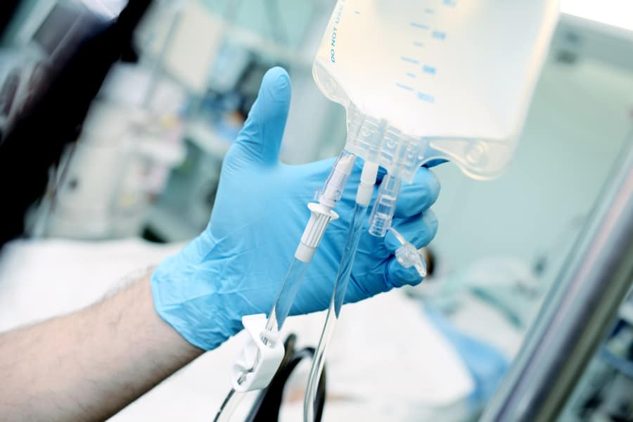
MDRO Infections - VRE
Developed because of use and misuse of antibiotics, including Vancomycin
Can be spread person to person
Can be facility-acquired
Drug of choice – Linezolid
Contact isolation for UTI, wound, or bloodstream infections
This Photo by Unknown Author is licensed under CC BY-NC-ND

Slide 23
MDRO Infections - ESBLs
ESBLs are bacteria that produce an enzyme which renders the bacteria resistant to many antibiotics
Most common are certain strains of Escherichia coli and Klebsiella pneumonia
Antibiotic of choice – Meropenem, Ertapenem (carbapenems)
Contact isolation for UTIs and wound infections

Slide 24
Prevent MDRO Infections - CRE
Carbapenem-Resistant Enterobacteriaceae (was originally called KPCs)
  Gram negative organisms such as Klebsiella
  Resistant to almost all antibiotics
  High rates of mortality and morbidity
  Strict attention to Isolation and Handwashing!!

Slide 25
MDRO Infections – other GNB
Several other gram-negative bacteria (GNB) are showing signs of resistance to many antibiotics
  Acinetobacter sp.,
  Stenotrophomonas sp.,
  Serratia sp.
Contact precautions
Handwashing is extremely important!

Slide 26
Other Infections – Clostidium difficile
While not considered a MDRO, still an important pathogen
Spore-forming bacteria that can be part of the normal flora
C.Diff occurs when normal intestinal bacterial flora is altered, often after administration of antibiotics, allowing C. diff to flourish and produce toxin, causing severe watery diarrhea
  Pseudomembranous colitis: inflammation of large intestine resulting from C.Diff

Slide 27
MDRO Infections – C. difficile
Patients at risk for C. diff - repeated enemas, prolonged NG tube insertion, GI surgery, overuse of antibiotics (penicillin, clindamycin, cephalosporins, etc.)
Patients with CDI shed spores in the stool that can be spread person to person

Slide 28
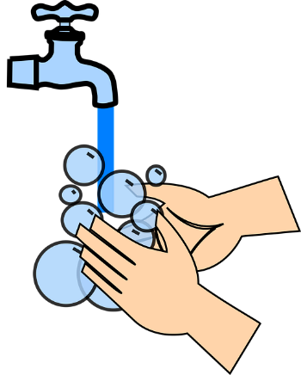
Prevent MDRO Infections – C. difficile
Spores can survive up to months or even years in the environment, and can be spread on the hands of healthcare workers who have direct contact with infected patients or environmental surfaces
Contact isolation
Strict adherence to handwashing –
no alcohol hand rubs!

Slide 29
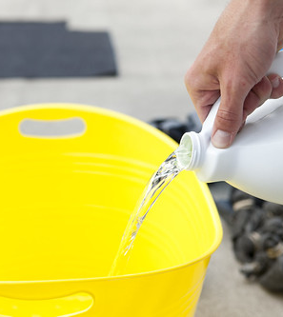
Prevent MDRO Infections –
C. difficile
Proper handling of contaminated wastes
CDC Environmental Guidelines – use bleach-based products when there is ongoing transmission of C. difficile
Limiting the use of antibiotics will lower the risk of developing CDI
Use of proton pump inhibitors (PPIs) may also play a part in increasing risk for CDI

Slide 30
C. difficile Risk Factors
Overuse of antibiotic therapy
Extended length of stay in health care facilities
Underlying diseases such as diabetes or immune suppression
Use of invasive devices, such as central lines, foley catheters, or ventilators
Age: > 65 years old, low birth weight neonates

Slide 31
C. difficile Modes of Transmission
Unwashed hands
Gloves worn from patient to patient
Contaminated environmental surfaces
Inadequately cleaned and disinfected equipment

Slide 32
Prevent MDRO Infections – Colonized vs. Infected
People who carry MRSA or VRE are said to be colonized.
Many kinds of bacteria live in (colonize) your body without causing an infection – this is your “normal flora”.
Carriers of MRSA usually have MRSA in their nares.
Carriers of VRE often have VRE in their bowel.

Slide 33
Prevent MDRO Infections – Colonized vs. Infected
People who are infected with MRSA or VRE have symptoms of infection, such as
fever
elevated WBC
purulent drainage, heat, redness (wound)
purulent sputum and positive CXR (respiratory)
dysuria, positive nitrate and leukocyte esterase (urine)

Slide 34
Prevent MDRO Infections: ASC
Active Surveillance Cultures (ASC)
  Nasal swab for presence of MRSA
  Positive result = patient is colonized with MRSA
  Does not mean patient has active infection – no need for antibiotics
  Physician MAY choose to decolonize patient with Bactroban (Mupirocin)

Slide 35
Prevent MDRO Infections – Colonized patients
Computer flags
  All patients with documented history of MRSA, VRE, ESBL, or CRE will have a computer flag placed on their medical record
  Patients with MRSA, VRE, and CRE flags will be placed in contact isolation upon subsequent readmissions to hospital

Slide 36
MDRO Infections:
Prevention and Control
Proper handwashing
Use antibiotics as prescribed
Instruct patients and families on importance of following the prescribed medication course and need for isolation
Isolate infected patients

Slide 37
Prevent MDRO Infections: Prevention and Control
Encourage family to continue to visit patient and assist in care as instructed
When transporting patients to other areas for testing, be sure appropriate measures are taken
When transferring a patient, notify receiving facility of resistance so appropriate measures can be implemented

Slide 38
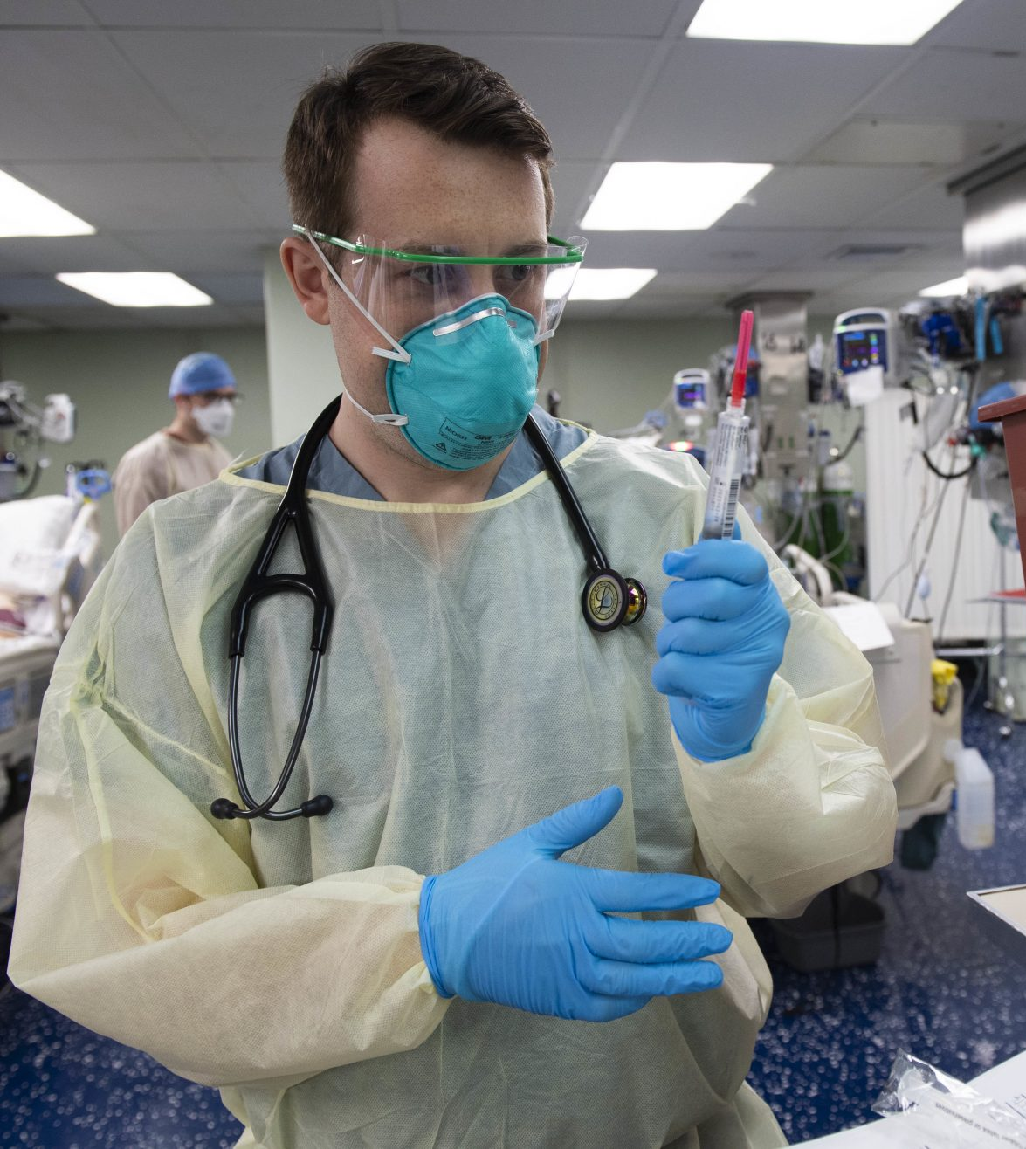
Prevent MDRO Infections:
Personal Protective Equipment (PPE)
Gloves – When encountering any body substances including urine and feces
Goggles – When conducting tasks or procedures that may create splashes or sprays
Gown – When tasks may lead to soiling or contact of clothing with contaminated items
Mask – According to posted instructions (Droplet or Airborne Isolation)

Slide 39
Prevent MDRO Infections: Prevention and Control
Use patient specific equipment when patient is in isolation (examples include blood pressure cuffs, thermometers, and tourniquets)
Clean and disinfect reusable equipment between patients – use bleach wipes for C. diff patients
Clean environmental surfaces regularly and when soiled with approved disinfectant

Slide 40
Prevent CLABSI Infections
Central Line-Associated Bloodstream Infections have serious consequences
  Mortality rate 12-25%
  Recent CDC estimate of >30,000 CLABSIs in US annually
  Average cost $70,696/patient

Slide 41
Prevent CLABSI Infections
Best practices to prevent CLABSIs:
  Use catheter checklist and standardized protocol for insertion
  Perform hand hygiene prior to catheter insertion or manipulation
  Avoid femoral sites unless other sites are unavailable
  Use standardized kit that contains all necessary components for insertion

Slide 42
Prevent CLABSI Infections
  Use standardized protocol for sterile barrier precautions
  Use CHG for skin preparation during insertion in patients >2 months of age
  Use standardized protocol to disinfect catheter hubs and injection ports
  Evaluate all central lines routinely and remove ASAP when peripheral access becomes sufficient

Slide 43
Prevent CLABSI Infections
CLABSIs are monitored on every patient with a central line or PICC in the hospital.
Insertion checklist must be completed and forwarded to Infection Prevention for monitoring of practice compliance.
CLABSI rates are calculated monthly and shared with staff, physicians, and senior leadership

Slide 44
Prevent Surgical Site Infections
Surgical Site Infections (SSI)
  Approximately 157,500 SSIs occur each year
  SSIs are associated with nearly 1 million additional inpatient days
  Estimated annual cost of $3.3 billion
  Most SSIs are preventable using evidence-based strategies

Slide 45
Prevent Surgical Site Infections
Best practices to prevent SSIs:
  Educate surgical patients and their families on SSI prevention
  Implement policies and procedures aimed at reducing SSIs
  Conduct risk assessments for SSIs and select SSI measures using best practices. Monitor compliance with these measures and evaluate effectiveness

Slide 46
Prevent Surgical Site Infections
  Measure SSI for the first 30 days following procedures that do not involve implants
  Measure SSIs for the first 90 days following procedures with implants
  Administer antimicrobial agents for prophylaxis according to best practices
  Use clippers or depilatories for hair removal – no razors
  PreOp CHG bathing

Slide 47
Prevent Surgical Site Infections
Preoperative bathing kits containing CHG are provided to patients undergoing certain procedures, such as total knee and hip, and some abdominal and intrathoracic surgeries.
Normothermia is maintained for patients during certain surgeries by using an active warming device intraoperatively.

Slide 48
Prevent Surgical Site Infections
Antimicrobial prophylaxis:
  Given within one hour before incision (two hours for Vancomycin or fluoroquinolones)
  Selected by type of procedure, most common pathogen for surgery site, patient’s weight, and published recommendations

Slide 49
Prevent Surgical Site Infections
  Redosing recommended if procedure is greater than 4 hours, major blood loss, or if antibiotic has short half-life
  Antibiotic is discontinued within 24 hours after surgery for most procedures unless documented infection is present

Slide 50
Prevent Surgical Site Infections
Other prevention measures include:
  Cleaning and disinfecting of equipment and environment
  Preparation and disinfection of operative site and hands of surgical team
  Hand hygiene
  Traffic control in/out of OR

Slide 51
Prevent CAUTI Infections
Catheter-Associated Urinary Tract Infections are the fourth most common type of healthcare associated infections (HAI) in the U.S.
>500,000 CAUTIs/year in US (ANA, 2025)
Combined cost of CAUTIs ~$1B
Research indicates most of these are preventable
15-25% of patients will have a urinary catheter placed during their hospitalization

Slide 52
Prevent CAUTI Infections
Patients with indwelling foleys are at greater risk for developing UTIs with risk of bacteriuria increasing with each day of use:
  Per day: ~5%
  One week: ~25%
  One month: ~100%

Slide 53
Prevent CAUTI Infections
Leading risk factors for CAUTI:
  Prolonged catheterization
  Female gender
  Catheter insertion outside the OR
In addition to cost and risk of infection, indwelling catheters also cause patient discomfort and restrict their ability to ambulate

Slide 54
Prevent CAUTI Infections
Best Practices to prevent CAUTI:
  Insert catheters only for appropriate indications:
    Acute urinary retention or obstruction
    Accurate measurement of urinary output in critically ill (ICU) patients
    Perioperative use in selected surgeries
    To assist healing of perineal and sacral wounds in an incontinent patient

Slide 55
Prevent CAUTI Infections
Appropriate Indications Continued:
  Hospice/comfort/palliative care
  Required immobilization for trauma or surgery
  Chronic indwelling urinary catheter on admission (from home or extended care facility)
Remove catheter ASAP when indications no longer apply.

Slide 56
Prevent CAUTI Infections
Maintain a sterile, continuously closed drainage system
Educate patients on CAUTI prevention and UTI symptoms
Remove catheters promptly when no longer needed
Daily monitoring of need for patient catheters is key!

Slide 57
Prevention of HAIs
Prevention of Healthcare-Associated Infections is at the heart of patient safety and is everyone’s role.
Implementation of these basic infection control and prevention recommendations will lead to decreased infection rates, reduced costs and most importantly - saved lives.

